Slide 1


INTRODUCTION TO SEABORN: PYTHON'S STATISTICAL DATA VISUALISATION LIBRARY
GROUP-9
GROUP MEMBER- SHIVESH TRIPATHI
SHIVANG SAROJ
YADVENDRA PRATAP SINGH
HARIOM MISHRA
ANKITA YADAV
ANKITA MISHRA

Slide 2
Introduction to Seaborn: Python's Statistical Data Visualisation Library
DISCOVER THE POWER OF CREATING STUNNING STATISTICAL VISUALISATIONS WITH MINIMAL CODE USING PYTHON'S PREMIER PLOTTING LIBRARY.

Slide 3

WHAT IS SEABORN?
Seaborn is a Python data visualisation library that makes statistical graphics both beautiful and intuitive. Built on top of Matplotlib, it integrates seamlessly with Pandas DataFrames.
The library simplifies the creation of attractive, informative statistical graphics through a dataset-oriented, declarative approach. This means you can focus on what insights you want to show rather than how to code every detail.

Slide 4
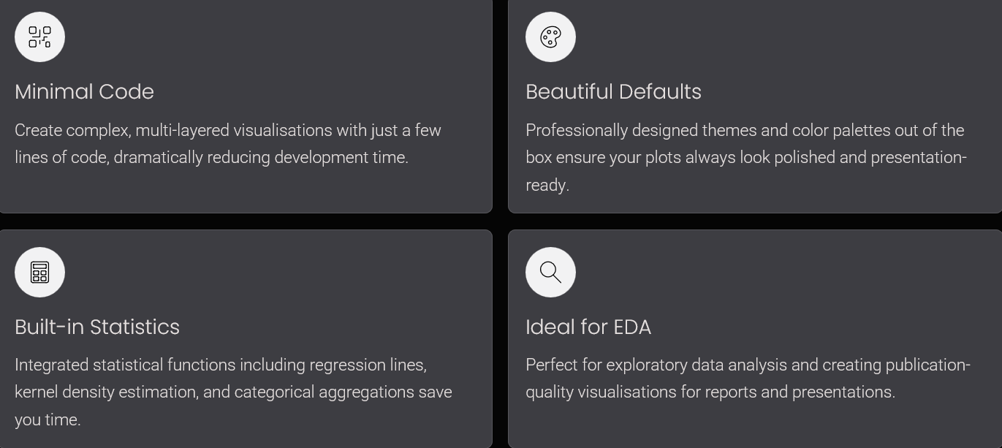
WHY USE SEABORN?

Slide 5
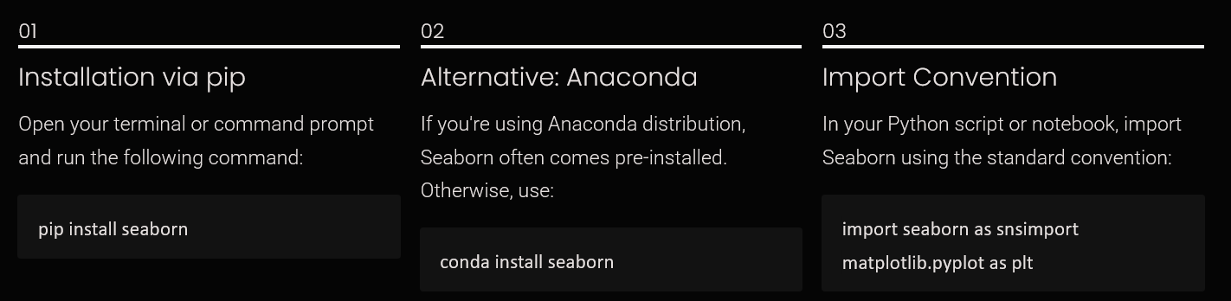
INSTALLING & IMPORTING SEABORN

Slide 6

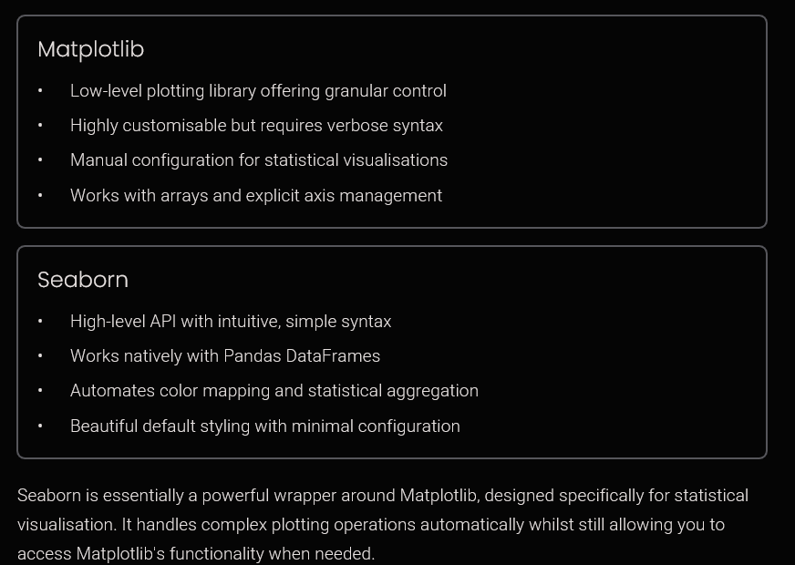
SEABORN VS MATPLOTLIB: KEY DIFFERENCES

Slide 7
CORE PLOT TYPES IN SEABORN
Distribution Plots
Relational Plots
Categorical Plots
Matrix Plots
Visualise the distribution of datasets using histplot(), kdeplot(), and distplot() for understanding data spread and patterns.
Compare categories using boxplot(), violinplot(), barplot(), and swarmplot() for statistical comparisons.
Display matrix data with heatmap() and clustermap() to reveal correlations and hierarchical patterns in your data.
Explore relationships between variables with scatterplot(), lineplot(), and the relplot() function. flexible

Slide 8

EXAMPLE: VISUALISING TIPS DATASET WITH RELPLOT()
Quick Insights with Minimal Code
  The Tips dataset demonstrates Seaborn's power. A single relplot() call can show the relationship between total bill and tip amount, whilst encoding additional dimensions:
  Hue differentiates smoker vs non-smoker
  Style varies marker shapes by category
  Size represents party size
sns.relplot(data=tips, x="total_bill", y="tip", hue="smoker" , size="size", style="time")

Slide 9
THANK YOU

